Slide 1

Priority Based VM Migration with Dynamic Load Balancing in Cloud Environment
NETAJI SUBHASH ENGINEERING COLLEGE
Presented
by
Team Members -
Ankita Dhar
Debak Bhattacharjee
Siddharth Roy
Subhrajit Dhar
Tanmay Dutta
Mentor : Prof. Soumen Swarnakar

Slide 2

CONTENTS
What is cloud Computing …….3
Cloud Model …….4
Cloud Services …….5
Load Balancing ….…6
Goals of load balancing …….7
Strategies of Load Balancing ……8
Types of load balancing algorithms ...…..9
Static load balancing
Dynamic load balancing
Load balancing Algorithms ……10 - 14
9. Cloud Sim ……15
10. Cloud Analyst ..….16
11. Proposed Algorithm ….17 - 18
12. Result Analysis of our Proposed
algorithm ……..19 - 20
13. Conclusion ……….21
14. References ………..22 - 23

Slide 3

What is Cloud Computing?
An Internet or network is referred to as the "cloud." To put it another way, a cloud is something that exists in a distant place.
Cloud computing is the practice of modifying, setting up, and using internet software.

Slide 4
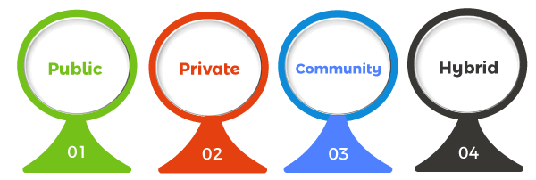
Cloud Models
The following are the most popular cloud implementation models:
Public
Private
Hybrid
Community Cloud

Slide 5
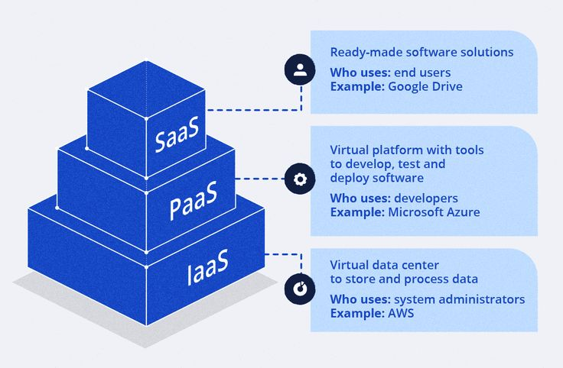
CLOUD SERVICES

Slide 6
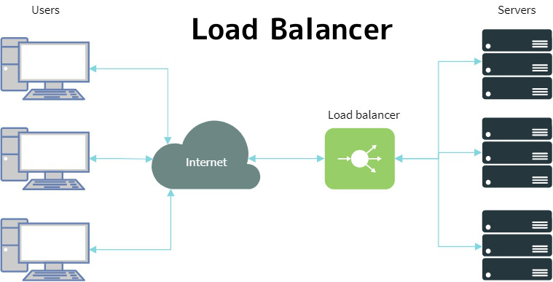
LOAD BALANCING
In cloud computing, load balancing distributes resources optimally among servers to provide effective management of workloads and network traffic.
The principal objectives are to optimize scalability, optimize resource allocation, reduce response times, and sustain high availability.

Slide 7
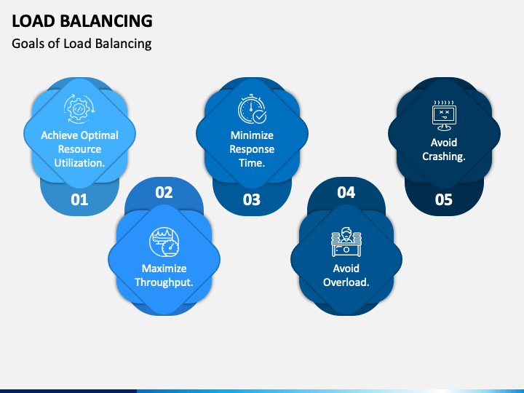
GOALS OF LOAD BALANCING
Achieves optimal resource utilization
Maximize throughput
Minimize response time
Avoids overload
Avoids crashing

Slide 8
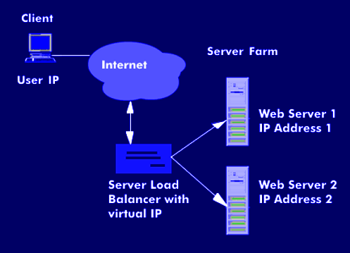

STRATEGIES OF LOAD BALANCING
SLB Architecture
Centralized :
These networks keep all of the data in one single computer location, and we access the information by logging into the system's primary computer, also referred to as the "server."
Distributed :
A collection of databases that are kept on different computers but seem to users as a single database is referred to as a distributed database.

Slide 9
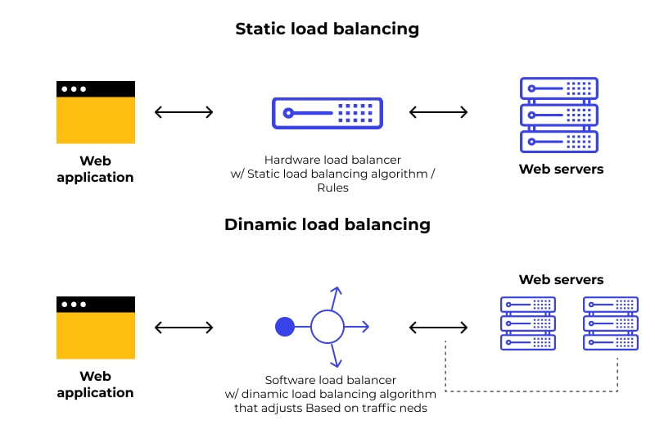


TYPES OF LOAD BALANCING ALGORITHMS
There are two types of Load Balancing algorithm:
Static Load Balancing algorithm: Often referred to as the mapping problem, the task is to map the a static process graph into a fixed hardware topology to minimize dilation and process load differences.
Dynamic Load Balancing algorithm: Here the system load is balanced evenly among the nodes thus minimizing the response time.

Slide 10
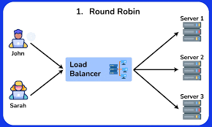
STATIC LOAD BALANCING
Round-Robin Method:
This technique uses a circular, sequential process to split up incoming network traffic or workload among several servers.
When a request arrives, the next available server in the queue is chosen. Each server in the pool handles requests in turn.
Advantages:
Ensures balanced distribution of resources
easy to understand and implement
It utilizes fewer resources.

Slide 11
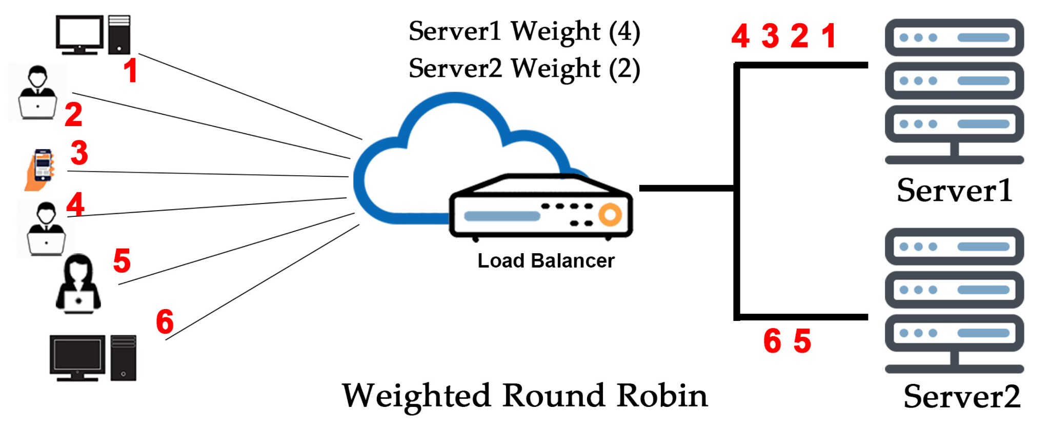
Weighted Round-Robin Method:
Each server is assigned a weight or priority based on its capabilities.
Servers with higher weights receive a proportionally larger share of incoming requests.
The distribution is still done in a circular or sequential manner, but the weights influence the frequency with which each server is selected.
Advantages:​
Prevents a server from receiving a large number of incoming requests.​
Utilizes fewer resources.​
Request assignment is deterministic and it is easy to determine the assigned server.​
The network administrator can set the numeric weight for the server.

Slide 12
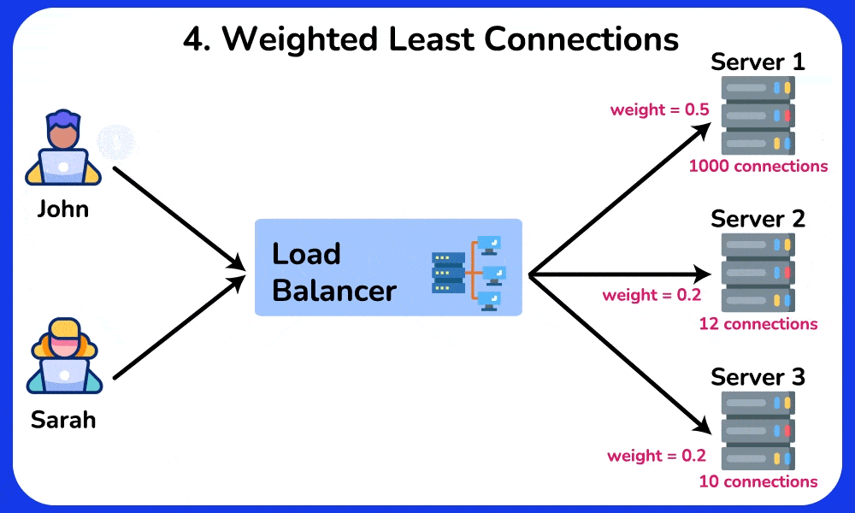
DYNAMIC LOAD BALANCING
Least Connections Load Balancing Technique:
Sends new requests to the server that currently has the fewest active connections.
The goal is to split up the workload so that each server is only managing a small number of connections.
In this case, resource consumption is optimized to avoid overloading any one server.
Advantages:
Minimizes the chances of server overload.
It is more reliable and responsive.

Slide 13

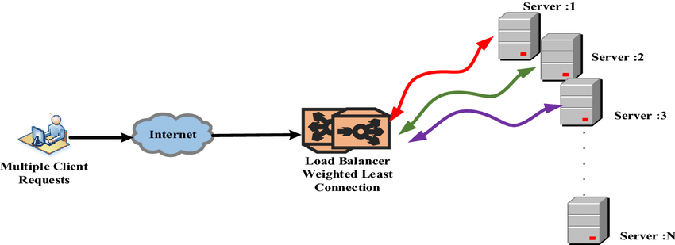
Weighted Least Connections load balancing
In order to take different application server features into consideration, it extends the least connection algorithm.
Based on the resources that are available and the processing power of each application server, the administrator gives each one a weight.
The given server weights and the number of active connections are the basis for load balancing choices.
Advantages:
It is considered a good method and almost devoid of problems.
Mostly provides accurate results

Slide 14
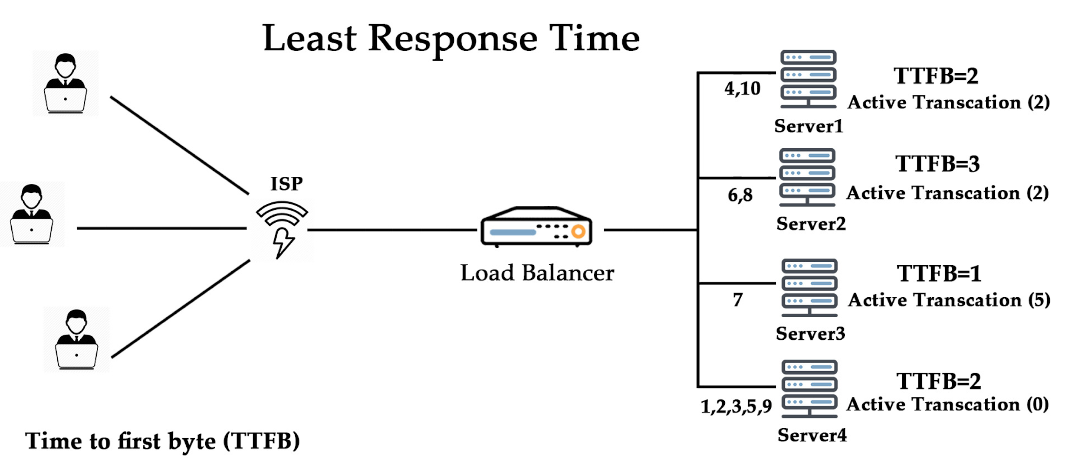
Least Response Time Load Balancing Technique:
Sends fresh queries to the server that currently has the quickest response time or latency.
Sending traffic to the server that can handle requests the quickest is the rationale behind this strategy.
The server that responds to requests the fastest is selected to handle the subsequent request after being observed.
.
Advantages:​
​
The least response time load balancing technique increases the availability time of servers.​
It assigns new requests evenly to each server to prevent overloading

Slide 15


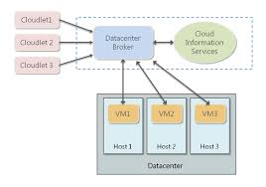
CLOUD SIM
CloudSim is a simulation toolkit that supports the modelling and simulation of the core functionality of the cloud, like job/task queue, processing of events, creation of cloud entities(datacenter, data center brokers, etc.), communication between different entities, implementation of broker policies, etc.

Slide 16


Specialized simulation tool designed for evaluating and analyzing the performance of cloud computing environments
Provides users with the ability to model cloud infrastructures and perform extensive testing of various deployment scenarios
Educational purposes, research & development and enterprise planning are the various use cases
CLOUD ANALYST
1

Slide 17

PROPOSED ALGORITHM
From our knowledge of previous existing algorithms, we came up with a new algorithm which is based on priority-based job migration. Here is an outlook of our proposed work:
Jobs come in queue with priority assigned - lower the numerical value, higher the priority.
Jobs with higher priority are shifted to VMs with higher configuration and jobs with lower priority are shifted to VMs with low configuration.
To ascertain the availability of the higher and lower configuration VMs, dynamic tables are used.
Tasks are allocated in queue to respective VMs and are executed. Now:

Slide 18
If a lower config. VM is overloaded, dynamic table looks for an available higher config. VM.
If a higher config. VM is available, then remaining execution time of jobs in queue is calculated.
If it is less than the sum of migration time and execution time in higher config. VM, it is not shifted
Else it is shifted. Again, in this case:
An average priority of these jobs are calculated.
Jobs with priority higher than the average priority are shifted to the higher config. VM.
5. If more jobs keep coming, steps from step 4 are repeated.

Slide 19
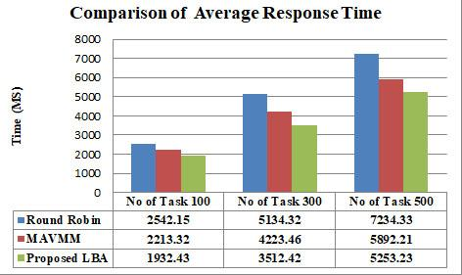
RESULT ANALYSIS
For the experiment's execution, the Cloud Analyst tool—a graphical user interface of Cloud Sim Architecture—was utilized. The simulation has a twenty-minute timeframe and takes into account six user bases situated in six distinct locations of the world.
The suggested experiment considers three data centers, with 10 virtual machines with a total memory of 2048 MB in each data center.
For the experiment simulation, 100, 300, and 500 jobs of varying durations have been selected at random.
Comparison of Avg. Response Time with different no. of Tasks

Slide 20
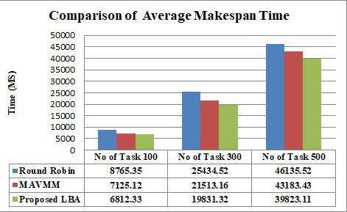
In the above two figures , it is seen that the proposed
algorithm is performing better than Round Robin and
MAVMM [1] in respect of average response time
and average makespan time.
Comparison of Avg. Response Time with different no. of Tasks
The algorithm that we have proposed has been compared with the already existing algorithm like Round Robin as well as the Multi-Agent-Based VM Migration (MAVMM) [1] algorithm.
Not only does our proposed algorithm assign jobs to the corresponding available VMs with lower or higher configuration but also based on their priority value. It ensures that not all the jobs in the waiting queue of lower configuration VMs are shifted to higher configuration VMs but only with higher priority tasks will be migrated if and only if remaining execution time is higher than migration time.

Slide 21


CONCLUSION
The algorithm that we have proposed has been compared with the already existing algorithm like Round Robin as well as the Multi-Agent-Based VM Migration The problem with the algorithms with which the proposed algorithm has been compared, did not consider factors such as priority of tasks.
Our proposed algorithm ensures that not all the jobs in the waiting queue of lower configuration VMs are shifted to higher configuration VMs but only with higher priority tasks will be migrated if and only if remaining execution time is higher than migration time.
This ensures maximum and efficient resource utilisation, executing all the tasks at an optimal time, thereby also reducing the Makespan time as well as response time.

Slide 22
REFERENCES
S. Swarnakar et al. (2023) [1] have created an algorithm (MAVMM) in their research article that entails moving jobs from virtual machines with a lot of load to ones with less load while also considering whether the migration is dependent on a lot of constraints. But in this algorithm priority of tasks have not been considered. In this proposed algorithm, it has been considered to execute the tasks.
Sefati et al. (2021) [2] suggested a new load-balancing technique for cloud environments based on the reliability of different resources. In this case, the method looks for nodes that are busy or idle before calculating the fitness function and threshold value for each node in order to assign tasks. The CloudSim simulation results showed that the anticipated solution has lower costs and a lower response time than the other approaches.
Hung et al. (2021) [12] created a two-phase evolutionary algorithm for load-balancing virtual machine hosts in a cloud computing system based on migration. Gene programming expressions have been utilized t results than the previously described methods in that particular paper.
S. Afzal and G. Kavitha, "Load balancing in cloud computing - A hierarchical taxonomical classification," Journal of Cloud Computing Advances, Systems and Applications, Vol 8, Article No 22, 2019.

Slide 23
C.K. Rath, P. Biswal and S.S. Suar, "Dynamic Task Scheduling with Load Balancing using Genetic Algorithm," 2018 International Conference on Information Technology (ICIT), Bhubaneswar, 2018, pp. 91-95.
S. Swarnakar, Z. Raza, S. Bhattacharya, C. Banerjee, “A Novel Improved Hybrid Model for Load Balancing in Cloud Environment”, Fourth International Conference on Research in Computational Intelligence and Communication Networks, 2018. doi:10.1109/ICRCICN.2018.8718697.
M. Kumar and S. C. Sharma, "Dynamic load balancing algorithm to minimize the makespan time and utilize the resources effectively in cloud environment," International Journal of Computers and Applications, Vol. 42, Issue 1, pp. 108-117, 2017.
R. J. Khan and Md. O. Ahmad, "A survey on load balancing algorithms in cloud computing," International Journal of Autonomic Computing (IJAC), Inderscience Pub., Vol. 2, No. 4, 2017.
O. Kaneria and R. K. Banyal, "Analysis and improvement of load balancing in Cloud Computing." 2016 International Conference on ICT in Business Industry & Government (ICTBIG), Indore, 2016, pp. 1-5, DOI: 10.1109/ICTBIG.2016.7892711.
A. Dave, P. Bhargesh and G. Bhatt, "Load balancing in cloud computing using optimization techniques: A study," 2016 International Conference on Communication and Electronics Systems (ICCES), Coimbatore, 2016, pp. 1-6. 10.1109/CESYS.2016.7889883.

Slide 24



Thank You

